Slide 1
Big Mountain Pricing Strategy
A Data Story

Slide 2
Problem

Slide 3
New Skiing Season… New Pricing Strategy?
Big Mountain Ski Resort (BM) is one of the premier ski resorts in Montana.
Their pricing strategy up til now has been to take the average price in the market and add a premium on top.
This year, they have decided to try something a little less arbitrary.
Additionally, they have added a new ski lift, which should help accommodate more visitors.
They estimate the new lift will cost around $1.54 million to operate.
Which leads to the big question...

Slide 4
Can Big Mountain change their pricing to offset the cost of the new lift while also staying profitable this season?
Here’s what the data says...

Slide 5
Short Answer: Yes!
Our models found that BM could be charging as much as $96, instead of the $81 charged currently.
That’s not to say “Push the price up, now!”
Instead, it means there’s room for adding to the price, based on the features of the park.
With the current price of $81, and an estimation of 350,000 visitors staying for 5 nights, revenue comes in at $141.75 million.
If tickets were bumped to $83, everything else staying the same produces $145.25 million.
That’s an additional $3.5 million to cover the cost of the new lift, with a little left over for extra profit.

Slide 6
Models and Analysis

Slide 7
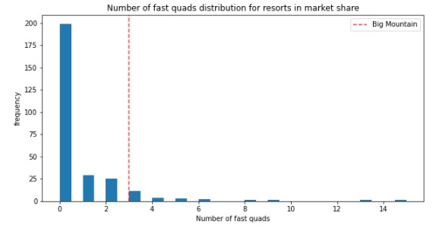
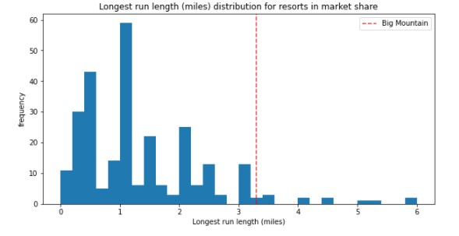
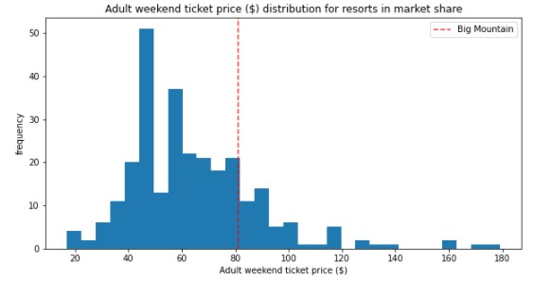
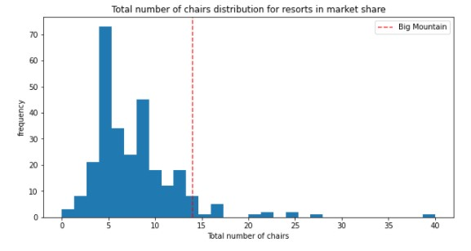
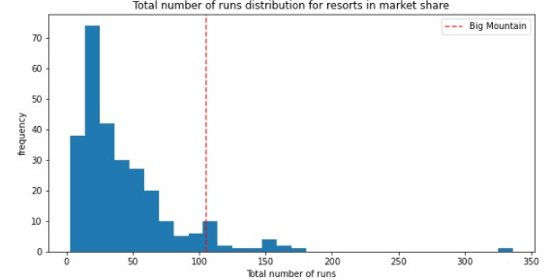
Big Mountain is a special place...
Consistently ranks in the top third for park features related to price.
However, they are priced in the middle of the pack (although, in Montana, priced at the top).

Slide 8
With such great features, surely we can do better?

Slide 9
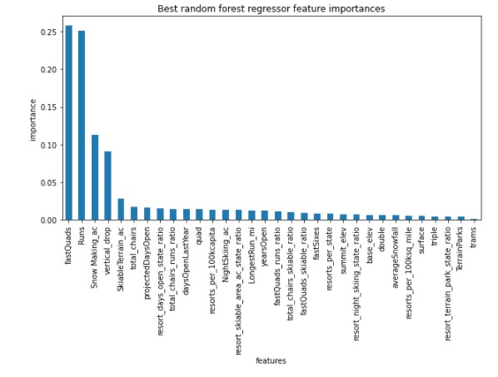
You’d be right!
Our model selected the best (potentially, most marketable) features for parks, and their basis for setting higher prices. Here they are, in order of importance:
Fast Quads
Runs
Snow Making
Vertical Drop
People want to be able to ski, and they want to minimize downtime. They also want variety. What’s also curious is that they want snow, on-demand. Fresh powder vs crud and ice. Sounds about right!

Slide 10
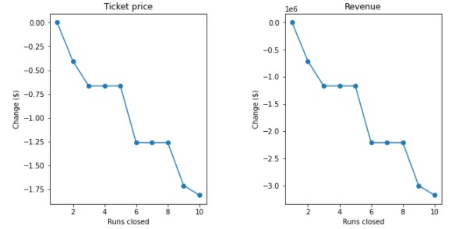
Cost cutting measures
Some days, runs will need to be closed (weather, maintenance, etc). When runs are closed, it may affect revenue, but how much really?
On days with 2 or less runs closed, revenue is minimally affect.
If 3 runs need to be closed, 5 runs can actually be closed, with no effect on revenue, but probably a significant effect on operating cost.
Same for 6 runs, where if 6 need closing, then closing 8 makes more sense.
Don’t close more than 8, unless it makes a major dent to operating costs.

Slide 11
Conclusion

Slide 12
Action Items
Talk to marketing. Because quads seem to be one of the drivers of price, highlight the new lift in respect to the new price.
For further price increases, look to add new runs, or expand snow making capabilities.
Lastly, if runs need to be closed, consider closing multiple to save more cost while minimizing effects on revenue.

